Slide 1
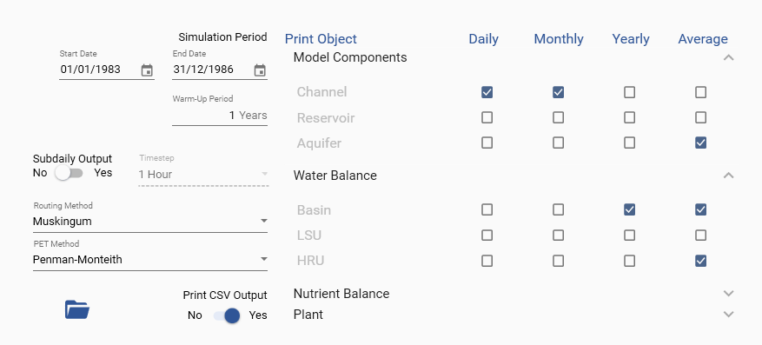
Collapse Arrow
Open TxtInOut
Expand Arrow
CSV Switch

Slide 2
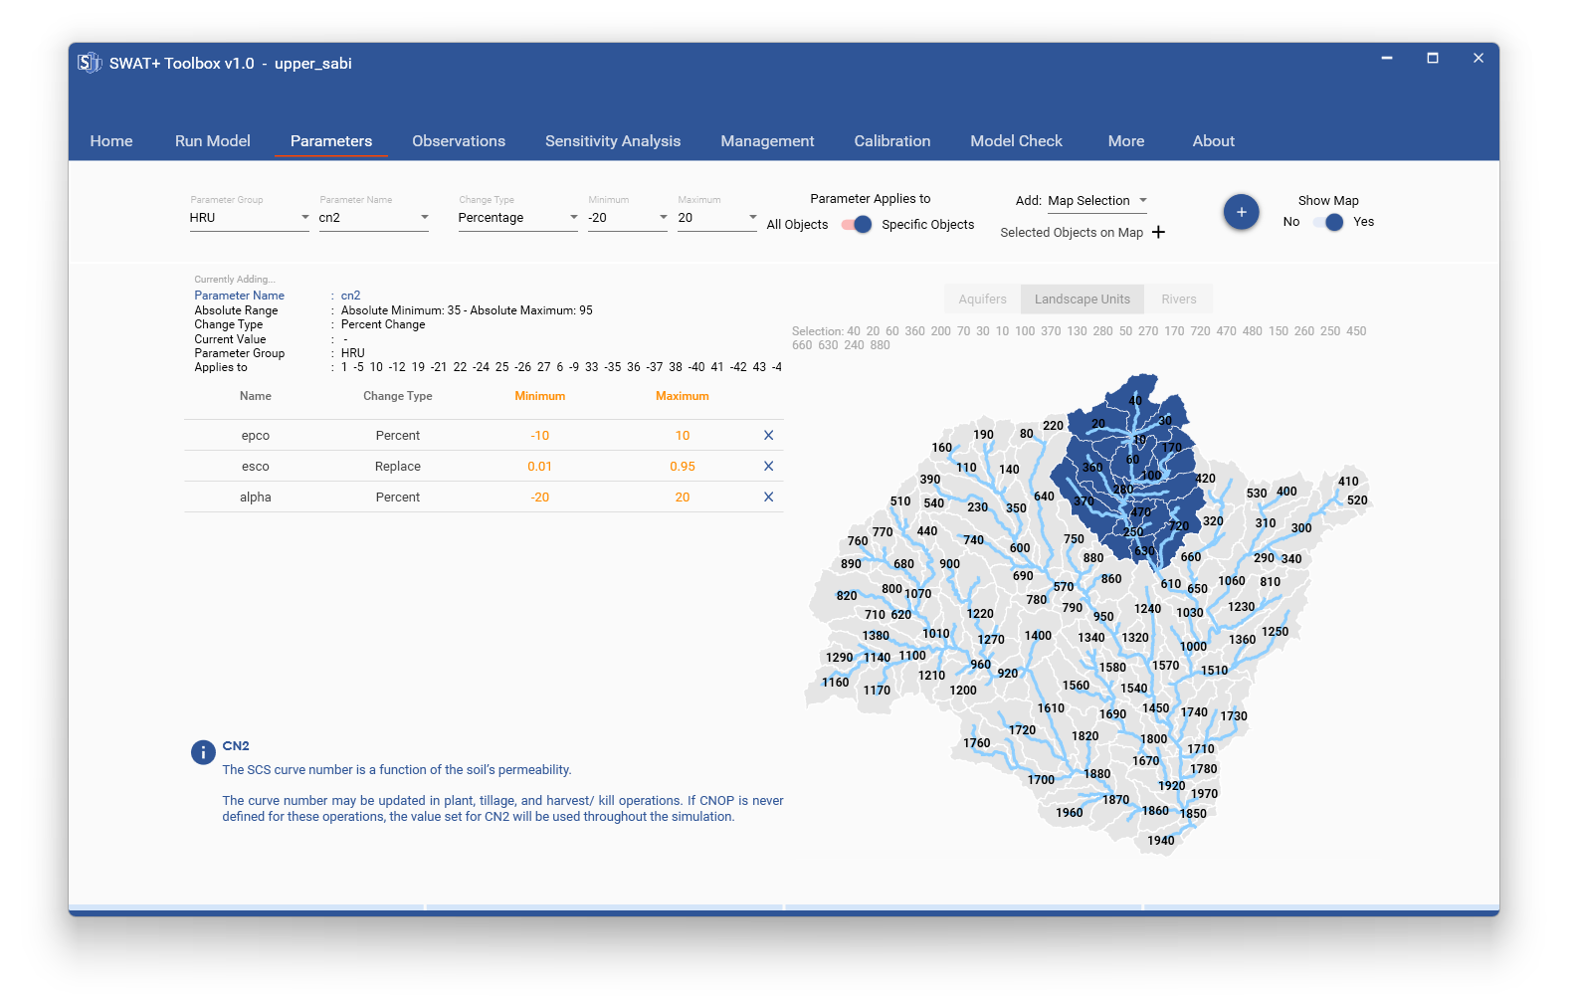
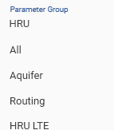
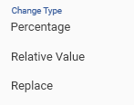
Add Parameter to specific objects
Map Switch
Add to Parameter Table
Collapse Arrow
Parameter Information Panel
Parameter Table
Map Object Selection

Slide 3
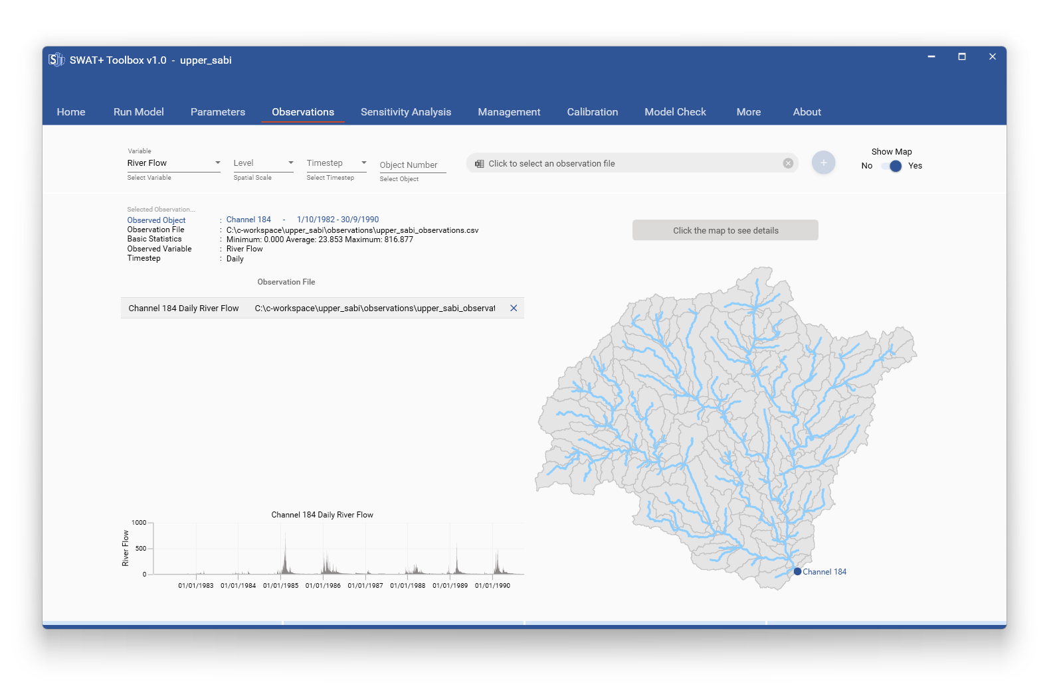
Observation Details Panel
Observations Table
Observation Chart Panel
Map Panel

Slide 4
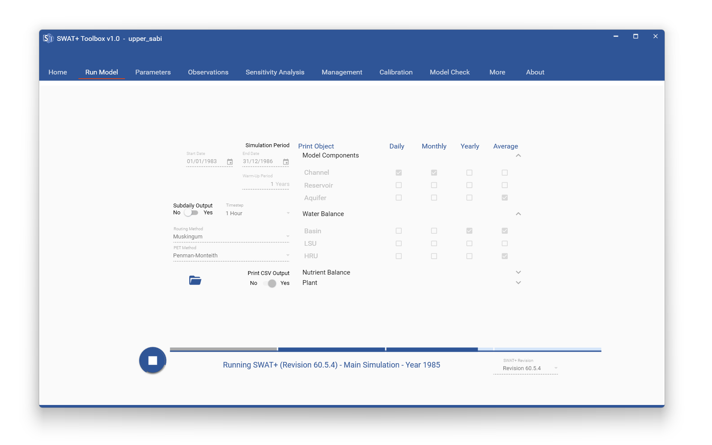
Warming Up
Printing Results Progress
Local Progress Bar

Slide 5
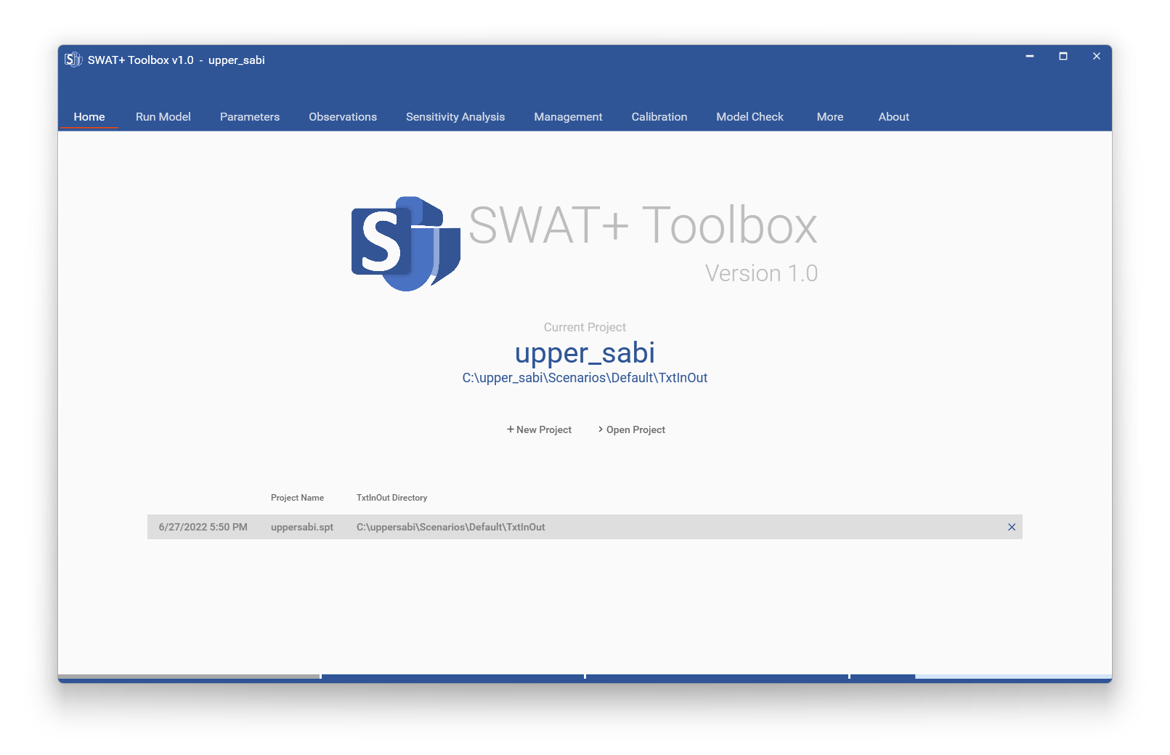
Global Progress Bar

Slide 6
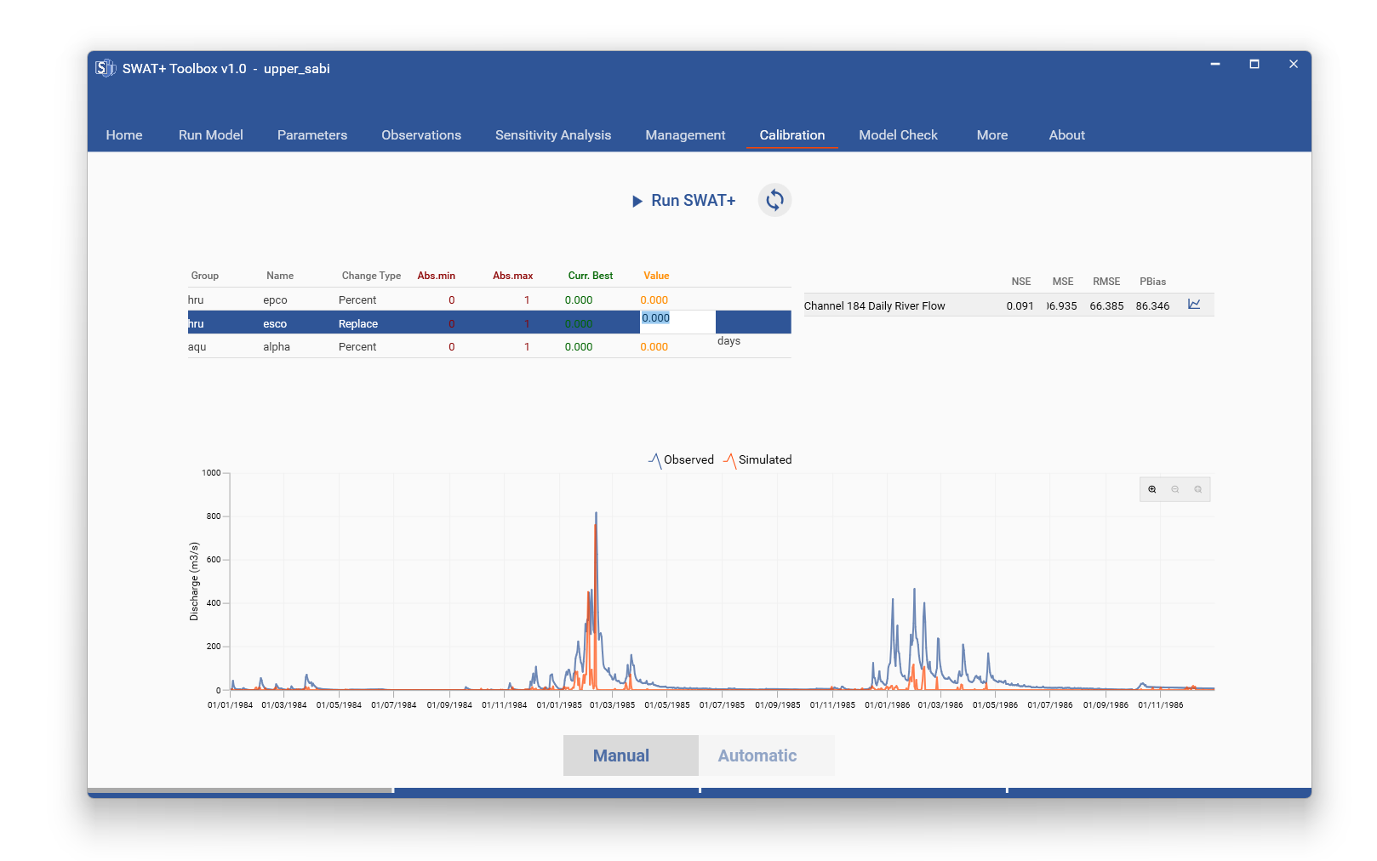
Warming Up
Parameters Panel
Performance Index Panel
Graphical Evaluation Panel

Slide 7
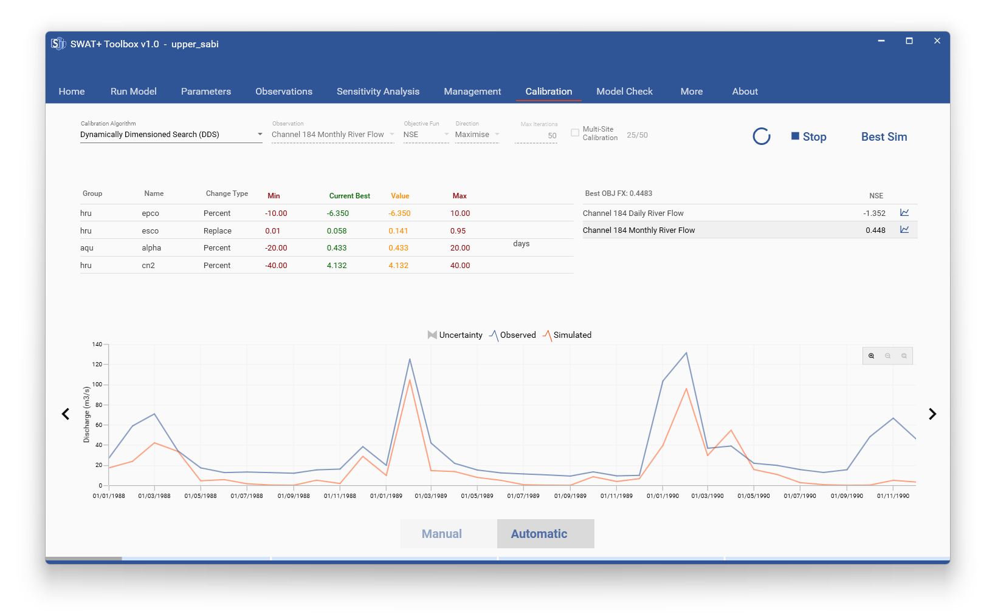
Maximum Iterations
Calibration Algorithm Panel
Objective Function Selection
Observation Selection
Switch View
Monitoring Panel

